Slide 1
Hippo pathway

Slide 2
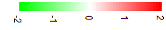
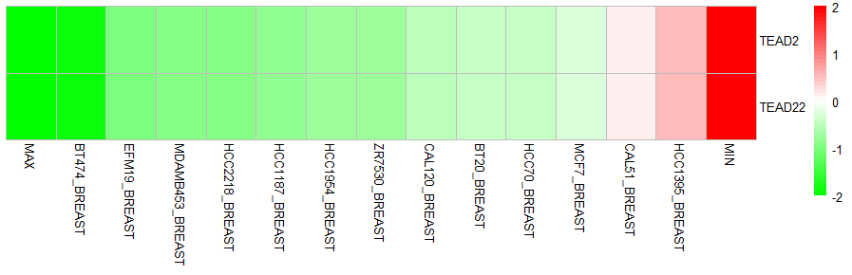
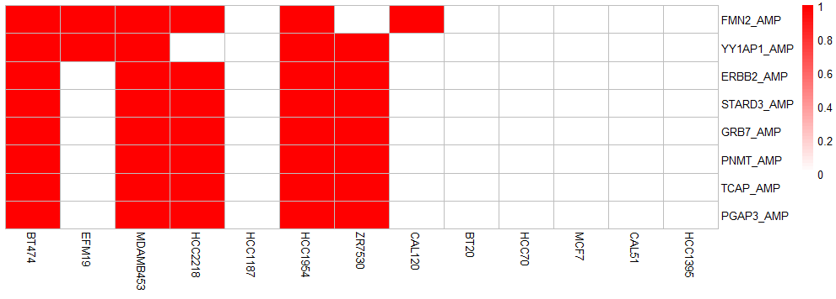
Copy number biomarkers for predicting TEAD2 dependency in breast cancer
(CCLE & shRNA database)
TEAD2 dependency
high
low

Slide 3
Pearson correlation of biomarkers’ dependency and TEAD2 dependency-1
n=34
PNMT
ERBB2
TCAP
GRB7
YAP1
TEAD2

